Slide 1

indra
From Classroom to Hero chapter-1

Slide 2
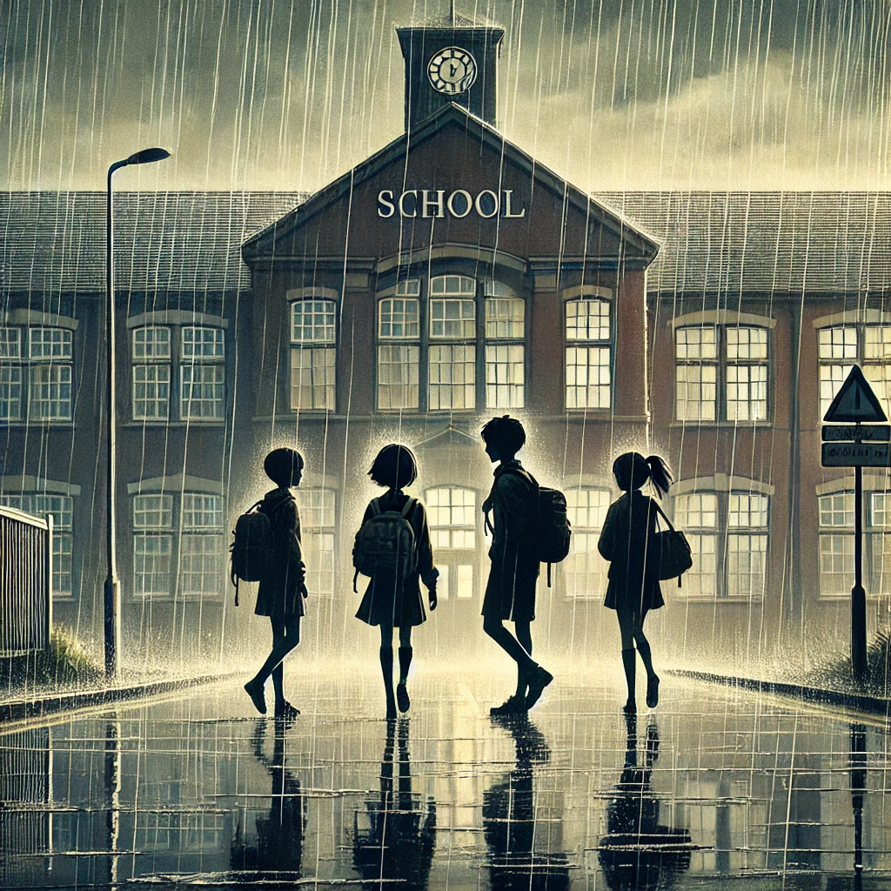


On a rainy evening, the boy and his two friends leave school after a long day.

Slide 3
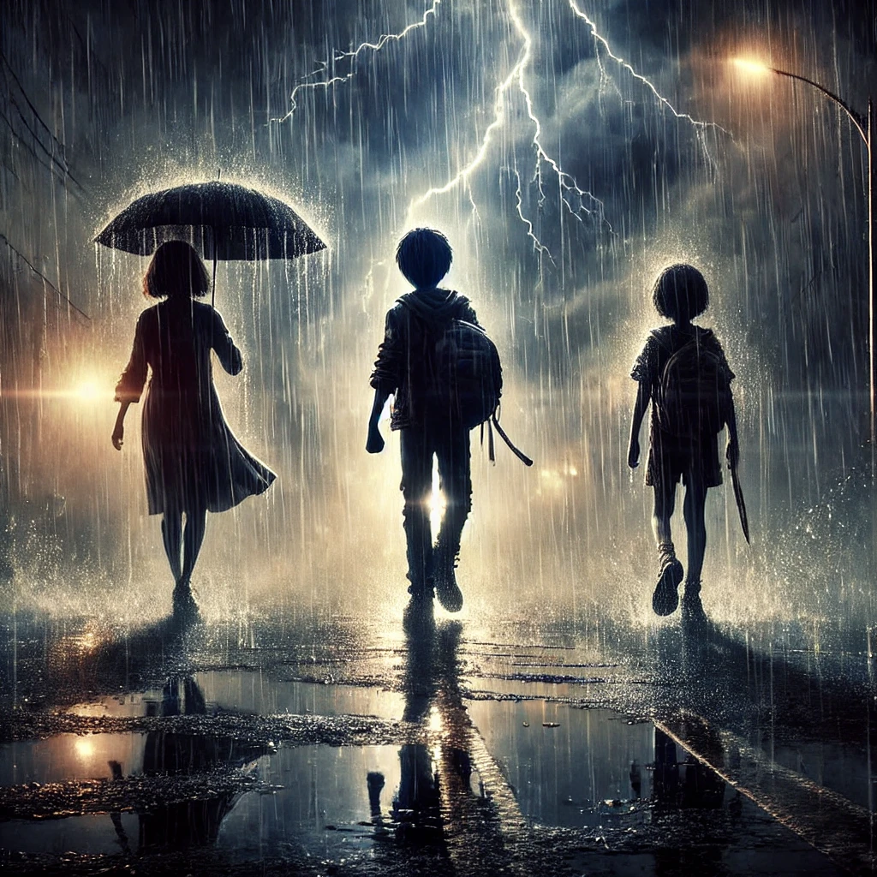
As they walk home, the rain gets heavier. The group talks about school and assignments, trying to ignore the downpour.

Slide 4
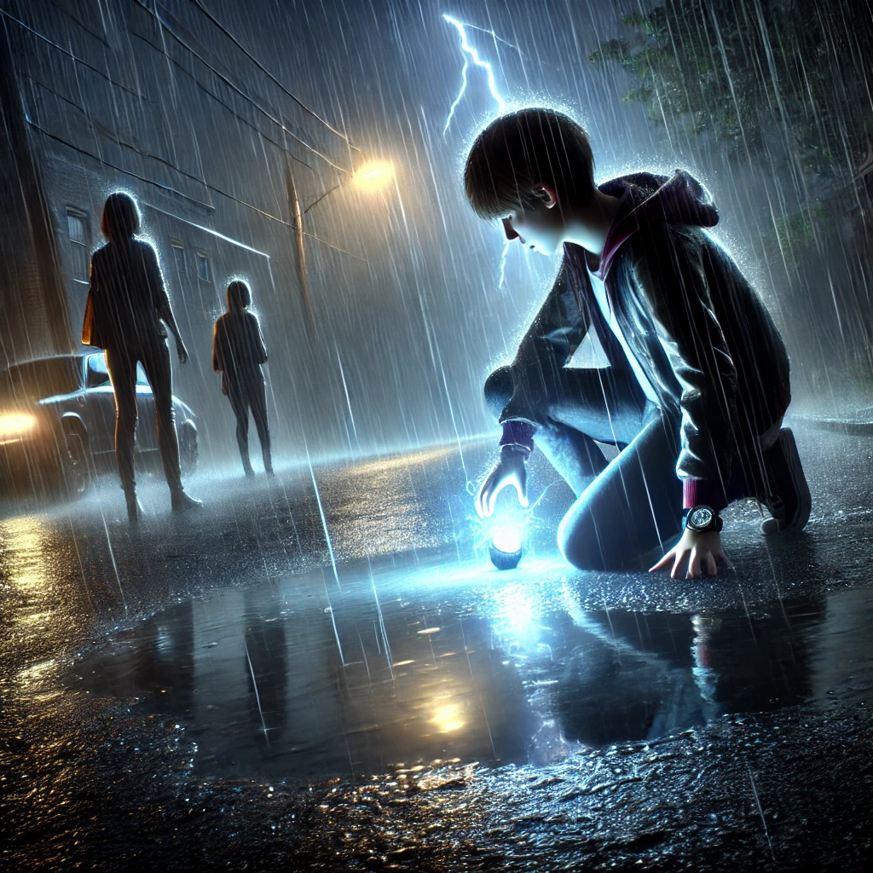
Suddenly, a loud thunderclap echoes through the air. The boy stops in his tracks, looking startled.
The boy spots a glowing object on the wet road ahead. He bends down to pick it up, curiosity overtaking him.

Slide 5
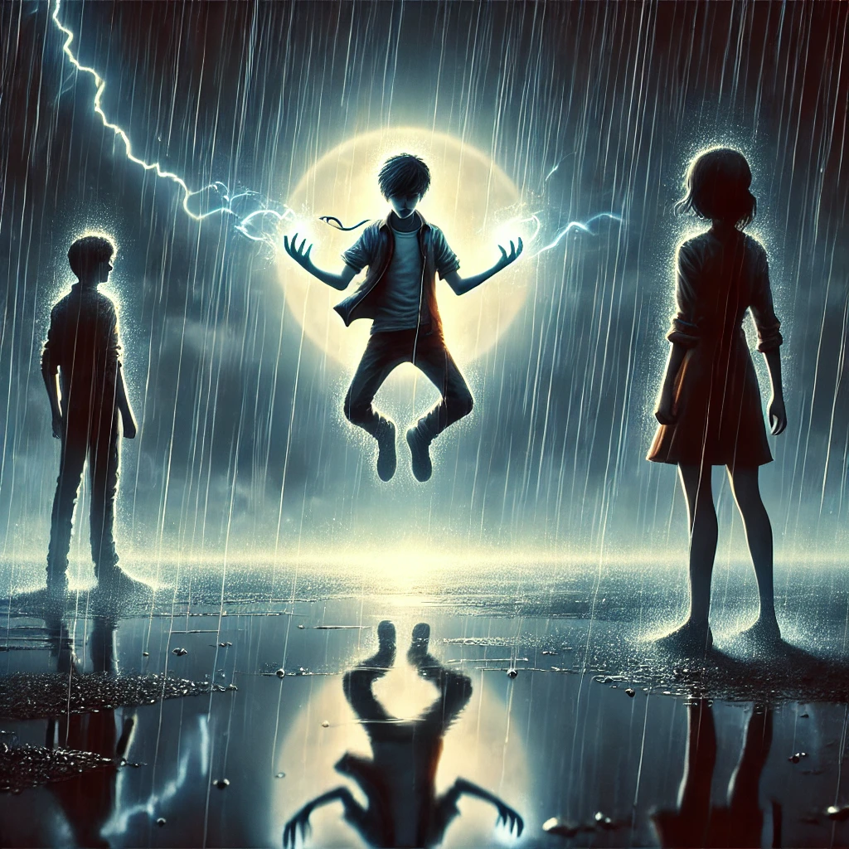
As the boy holds the object, energy flows through him. His body starts to glow faintly, and he begins to lift off the ground.

Slide 6
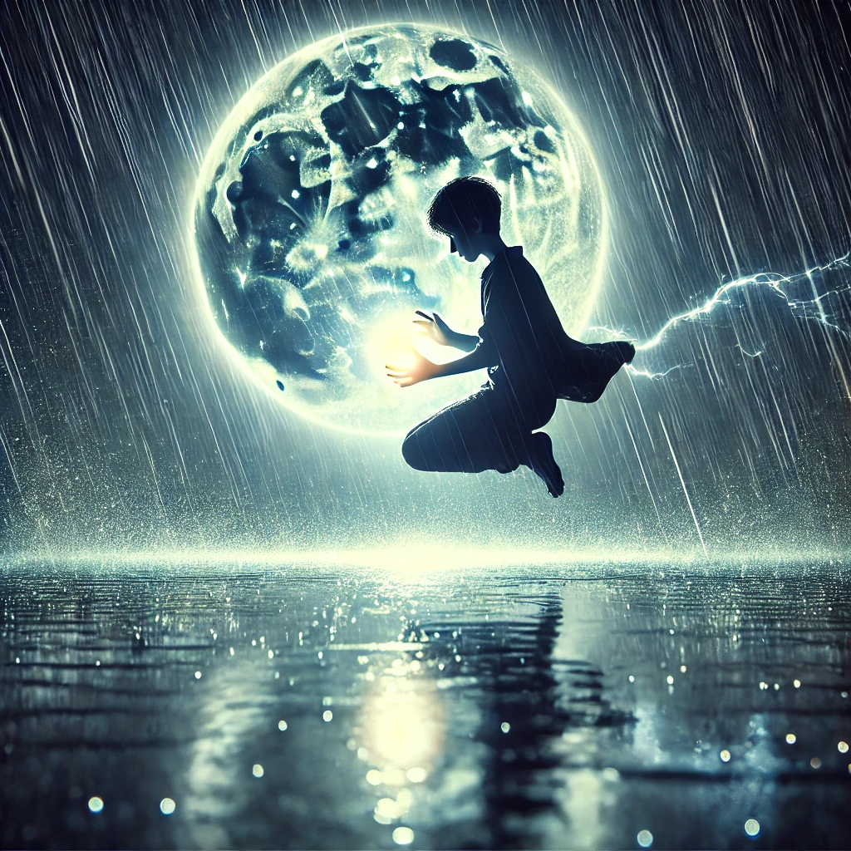
The boy slowly begins to understand that he has gained superpowers.

Slide 7
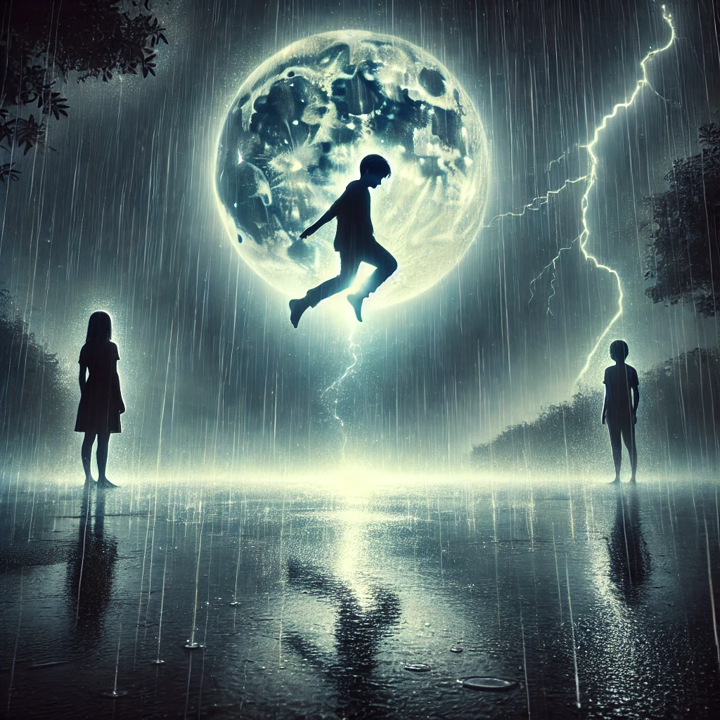
The boy hovers in the air, energy radiating from him. His friends look up in awe and disbelief, realizing their lives will change forever.

Slide 8
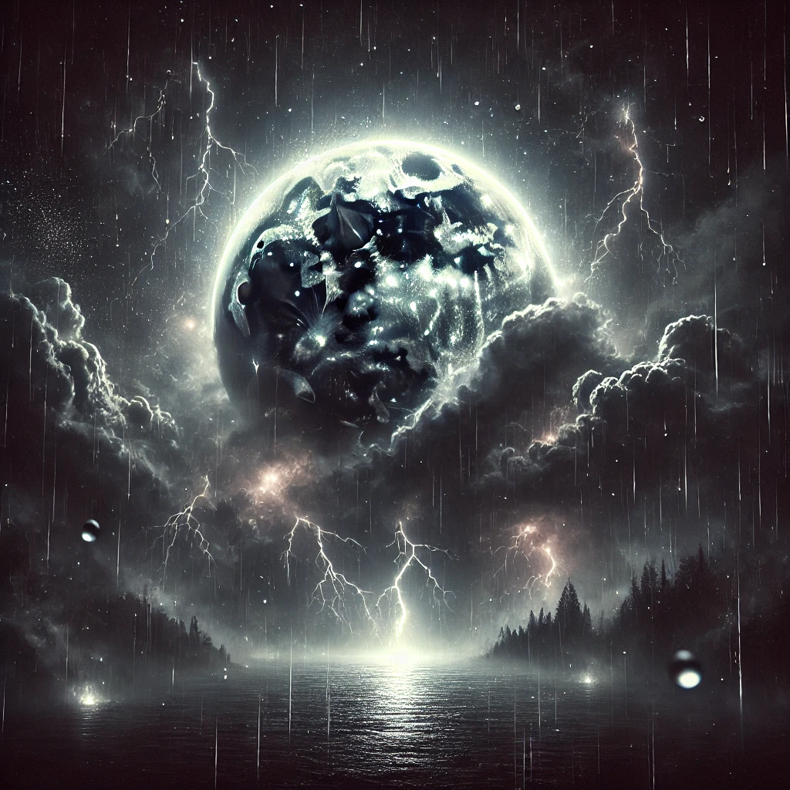
Stay tuned to uncover the mystery: How did the boy gain his powers? Where did they come from? And what is the reason behind them?
- Dilip Vummaneni

